Slide 1
Wednesday - Message Web Application
Group Presentation

Slide 2
Group Member :
Members: {zhou.liha, liu.bo2, chen.jiey, tong.xi}@husky.neu.edu
001302072 Lihang Zhou
001057068 Bo Liu
001398614 Jieying Chen
001306762 Xing Tong

Slide 3





Part 1:
Welcome Page
Part 3:
Chat Page
Part 5:
Back-End
THANK YOU!
Part 4:
Profile
Part 2:
Login Page

Slide 4
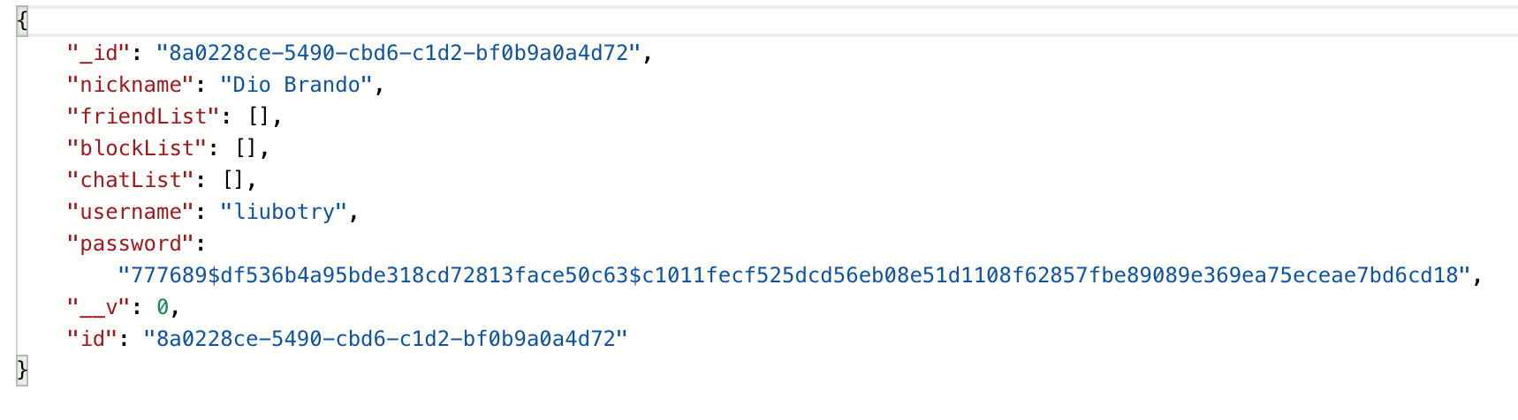
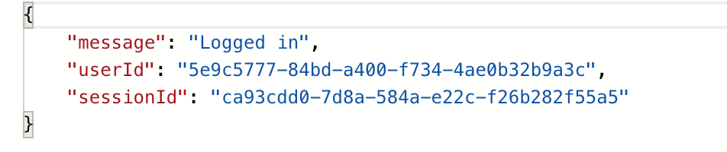
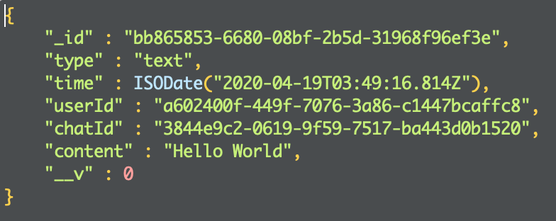
Data Structure
1.User Data Structure
· password is encrypted in the backend instead of plaintext.
2.Message Data Structure
·give new session Id while user log in every time.

Slide 5
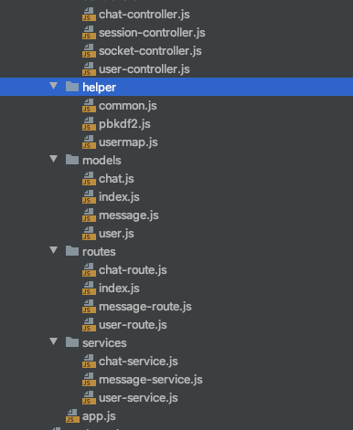
Back-End:
File Structure:
DataBase
Register ID
User ID
Chat message

Slide 6

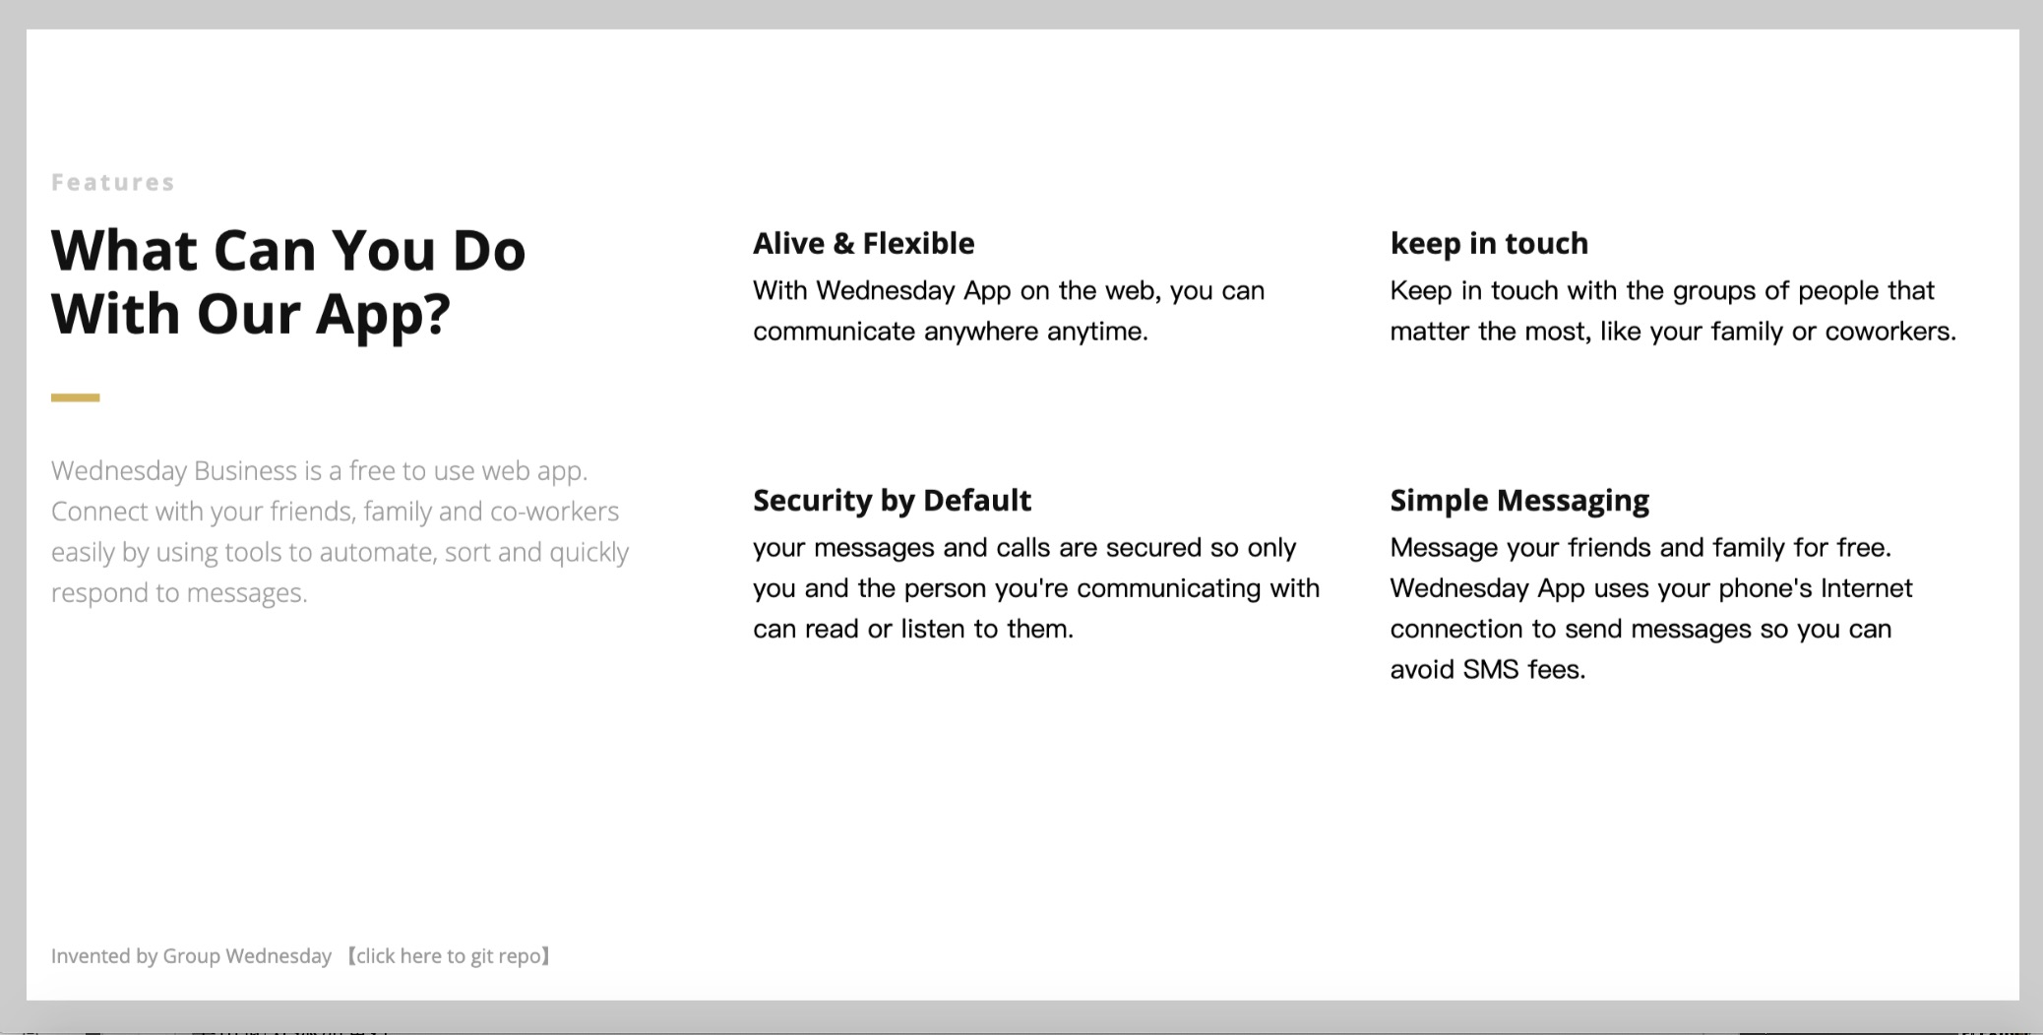
User Interface

Slide 7
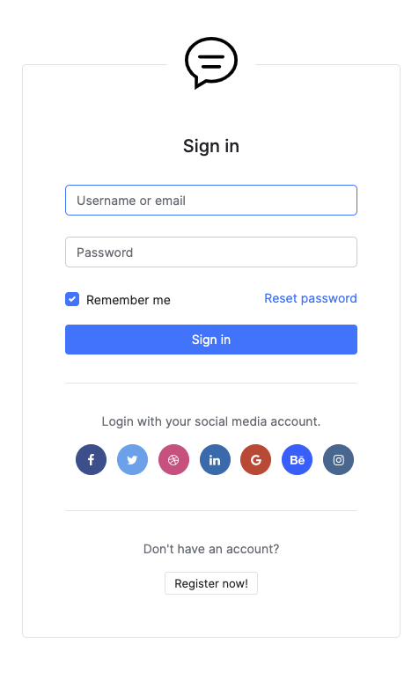
Login-page：

Slide 8
Chat-page：

Slide 9
THANK YOU

